Slide 1
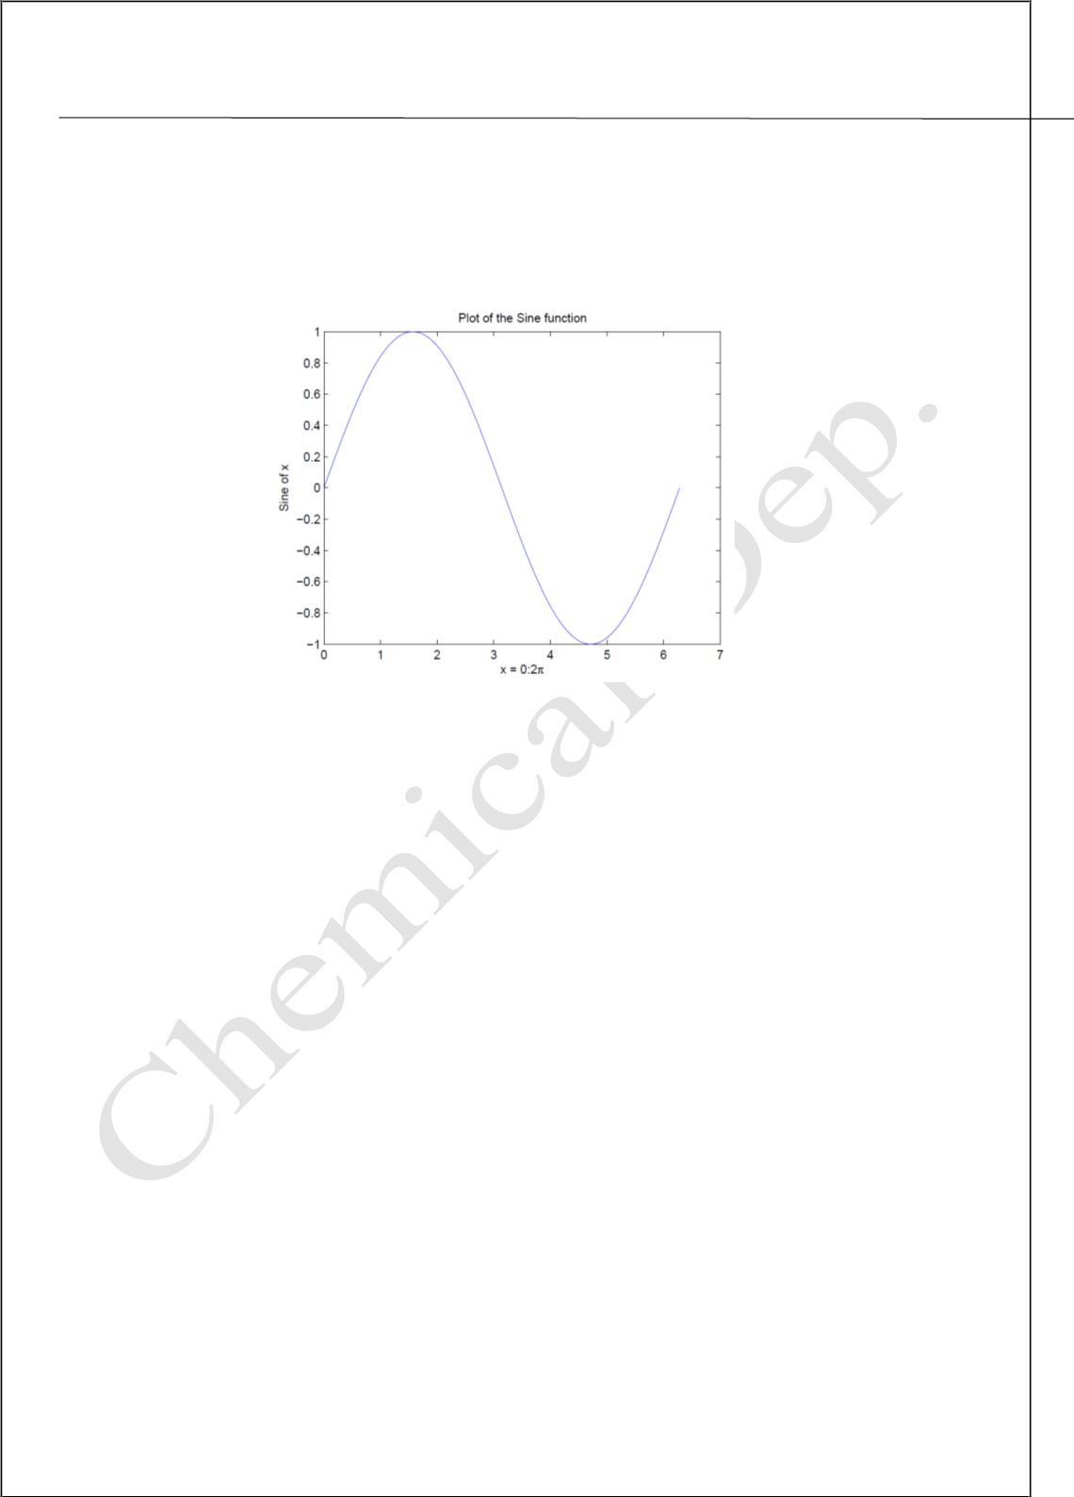
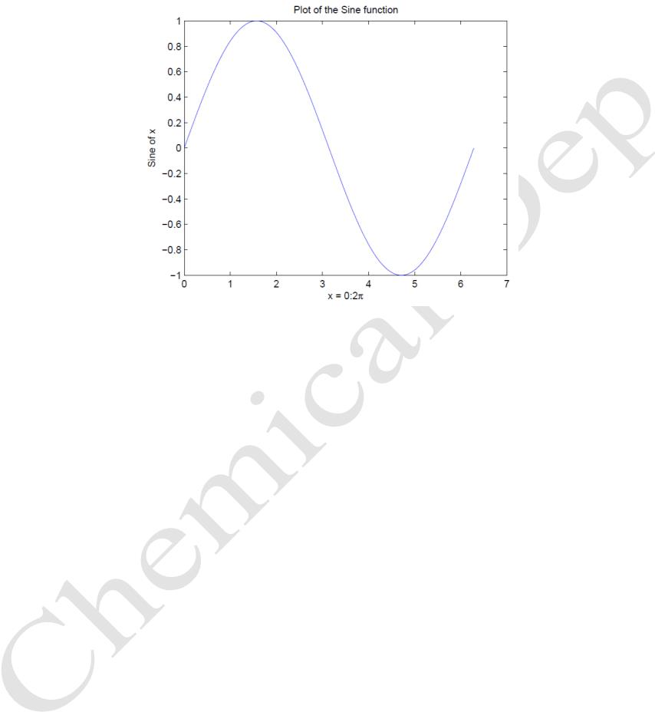
Lecturer
MatLab
Diyala university / College of Engineering
Omar A. Imran
Department of Chemical Eng.
Second Class
2019 – 2020
2.3 Adding titles, axis labels, and annotations
MATLAB enables you to add axis labels and titles. For example, using the graph from
the previous example, add an x- and y-axis labels. Now label the axes and add a title. The
character \pi creates the symbol ¼. An example of 2D plot is shown in Figure 2.2.
Trail Version
Trail Version
Trail Version
Trail Version
Trail Version
Trail Version
Trail Version
Trail Version
Trail Version
Trail Version
Trail Version
Trail Version
Trail Version
Figure 2.2: Plot of the Sine function
>> xlabel('x = 0:2\pi')
>> ylabel('Sine of x')
>> title('Plot of the Sine function')
The color of a single curve is, by default, blue, but other colors are possible. The desired
color is indicated by a third argument. For example, red is selected by plot(x,y,'r'). Note
the single quotes, ' ', around r
2.4 Multiple data sets in one plot
Multiple (x; y) pairs arguments create multiple graphs with a single call to plot. For
example, these statements plot three related functions of x: y1 = 2 cos(x), y2 = cos(x),
and y3 = 0.5 * cos(x), in the interval 0 ≤ x ≤ 2π.
>> x = 0:pi/100:2*pi;
>> y1 = 2*cos(x);
>> y2 = cos(x);
>> y3 = 0.5*cos(x);
>> plot(x,y1,'--',x,y2,'-',x,y3,':')
>> xlabel('0 \leq x \leq 2\pi')
>> ylabel('Cosine functions')
>> legend('2*cos(x)','cos(x)','0.5*cos(x)')
>> title('Typical example of multiple plots')
The result of multiple data sets in one graph plot is shown in Figure 2.3.
41

Slide 2
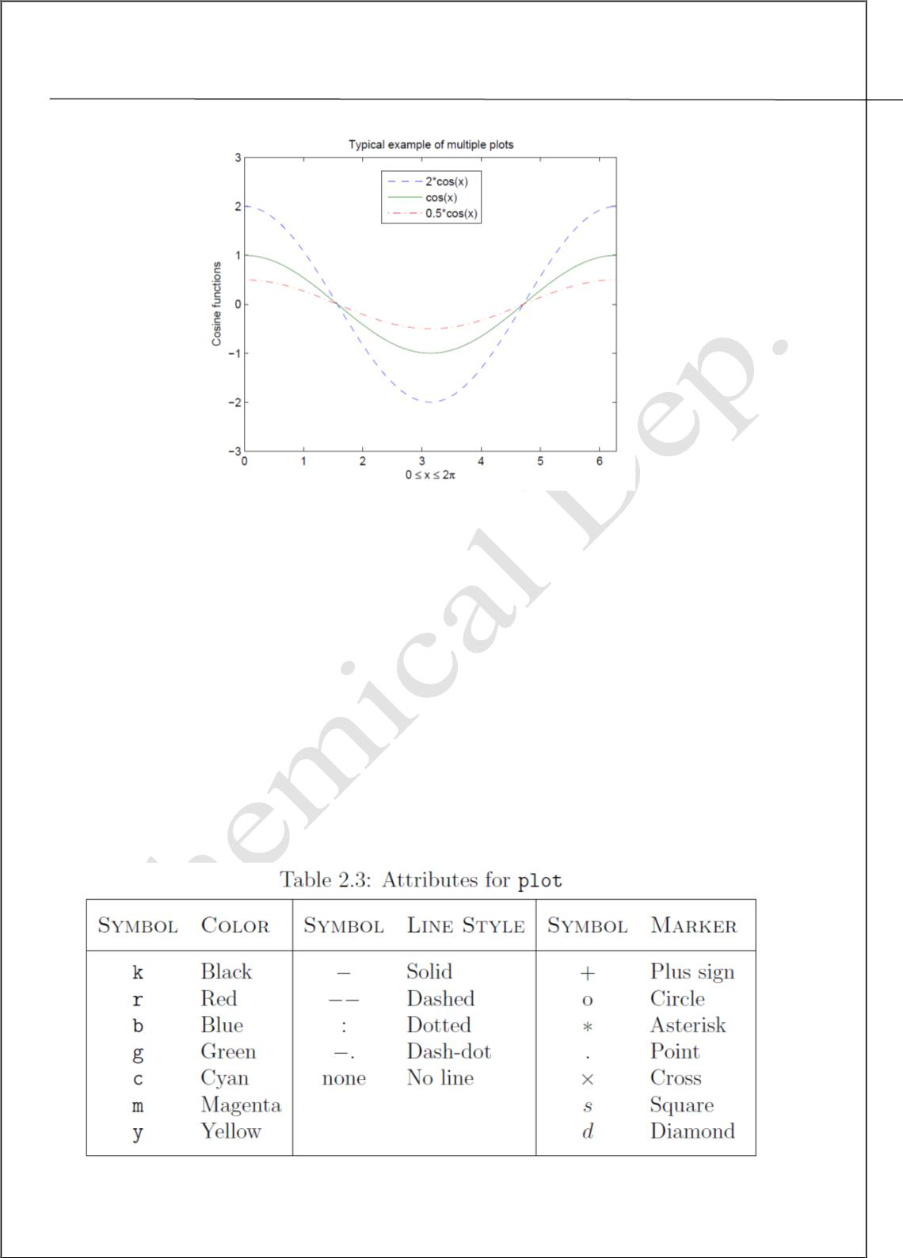
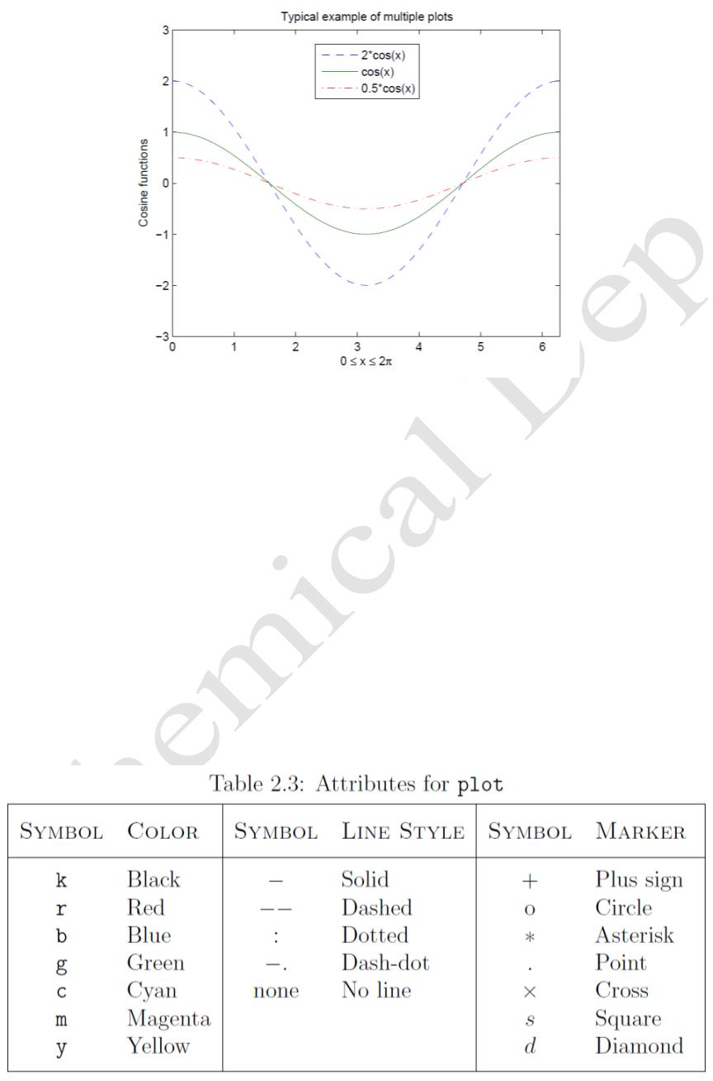
Lecturer
MatLab
Diyala university / College of Engineering
Omar A. Imran
Department of Chemical Eng.
Second Class
2019 – 2020
Figure 2.3: Typical example of multiple plots
By default, MATLAB uses line style and color to distinguish the data sets plotted in the
graph. However, you can change the appearance of these graphic components or add
annotations to the graph to help explain your data for presentation.
Trail Version
Trail Version
Trail Version
Trail Version
Trail Version
Trail Version
Trail Version
Trail Version
Trail Version
Trail Version
Trail Version
Trail Version
Trail Version
2.5 Specifying line styles and colors
It is possible to specify line styles, colors, and markers (e.g., circles, plus signs, . . . )
using
the plot command:
plot(x,y,'style_color_marker')
where style_color_marker is a triplet of values from Table 2.3.
To find additional information, type help plot or doc plot.
42

Slide 3
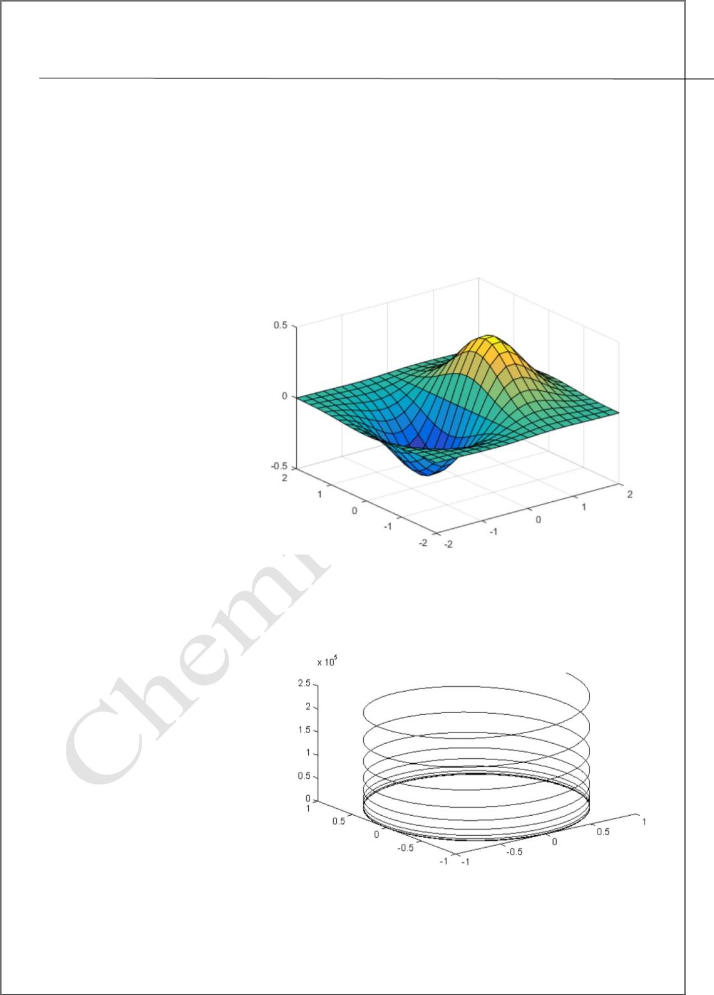
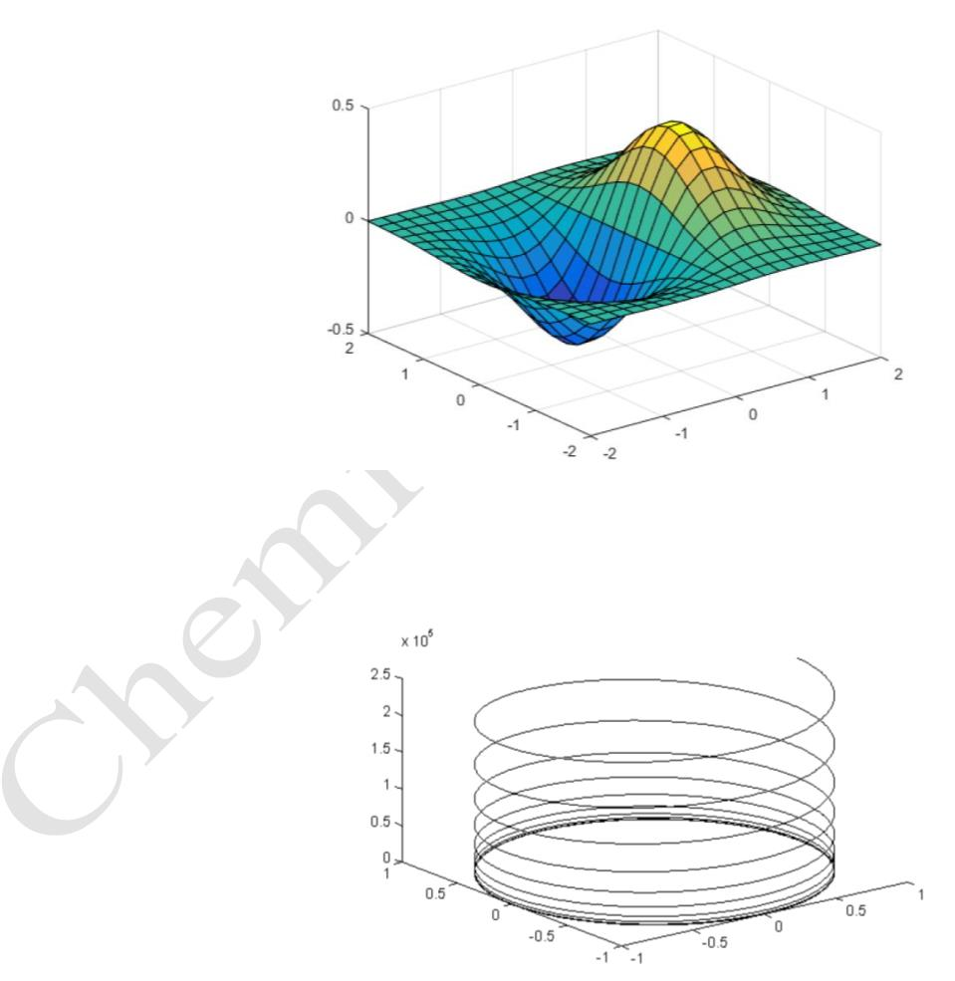
Lecturer
MatLab
Diyala university / College of Engineering
Omar A. Imran
Department of Chemical Eng.
Second Class
2019 – 2020
3-D Plots
Three-dimensional plots typically display a surface defined by a function in two
variables, z = f(x,y) .
To evaluate z, first create a set of (x,y) points over the domain of the function using
meshgrid.
[X,Y] = meshgrid(-2:.2:2);
Z = X .* exp(-X.^2 - Y.^2);
Then, create a surface plot.
surf(X,Y,Z)
Both the surf function and its
companion
surfaces in three dimensions.
surf displays both
mesh
display
Trail Version
Trail Version
Trail Version
Trail Version
Trail Version
Trail Version
Trail Version
Trail Version
Trail Version
Trail Version
Trail Version
Trail Version
Trail Version
the
connecting lines and the faces
of the surface in color. Mesh
produces wireframe surfaces
that color only the lines connecting the defining points.
t=.01:.01:20*pi;
x=cos(t);
y=sin(t);
z=t.^3;
plot3(x,y,z)
The re resulting plot is shown in
below
43

Slide 4
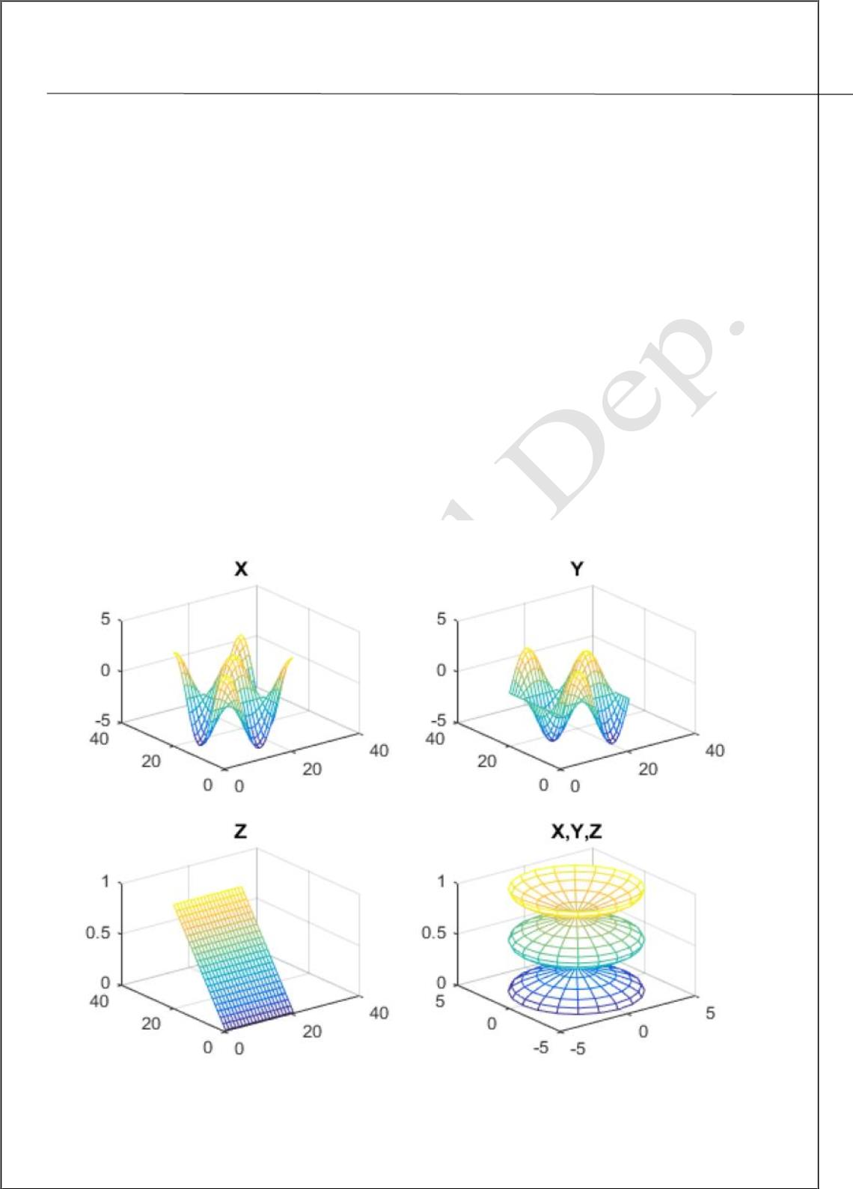
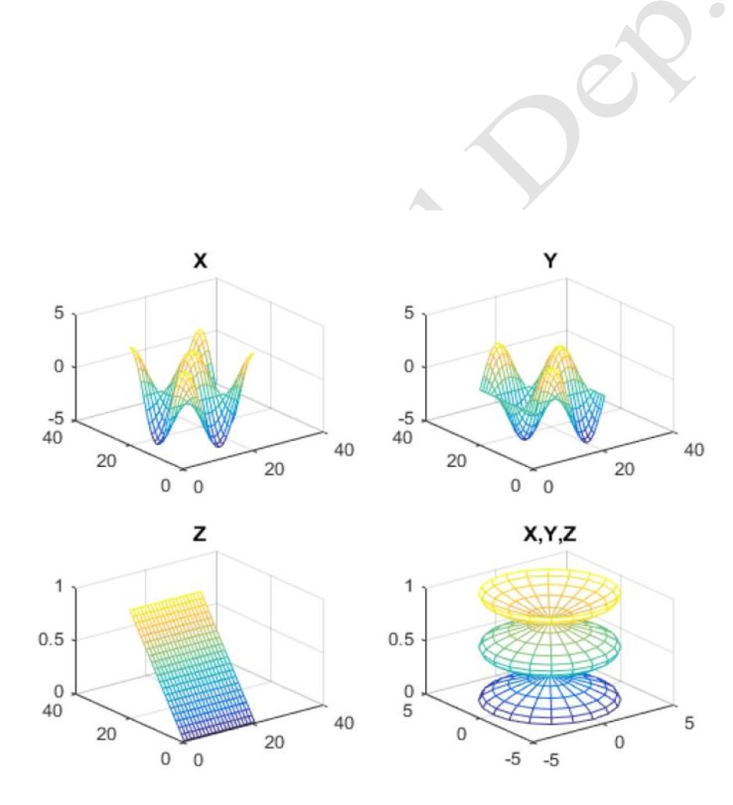
Lecturer
MatLab
Diyala university / College of Engineering
Omar A. Imran
Department of Chemical Eng.
Second Class
2019 – 2020
Subplots
You can display multiple plots in different sub regions of the same window using the
subplot function.
The first two inputs to subplot indicate the number of plots in each row and column. The
third input specifies which plot is active. For example, create four plots in a 2-by-2 grid
within a figure window.
t = 0:pi/10:2*pi;
[X,Y,Z] = cylinder(4*cos(t));
subplot(2,2,1); mesh(X); title('X');
subplot(2,2,2); mesh(Y); title('Y');
subplot(2,2,3); mesh(Z); title('Z');
subplot(2,2,4); mesh(X,Y,Z); title('X,Y,Z');
Trail Version
Trail Version
Trail Version
Trail Version
Trail Version
Trail Version
Trail Version
Trail Version
Trail Version
Trail Version
Trail Version
Trail Version
Trail Version
44

Slide 5
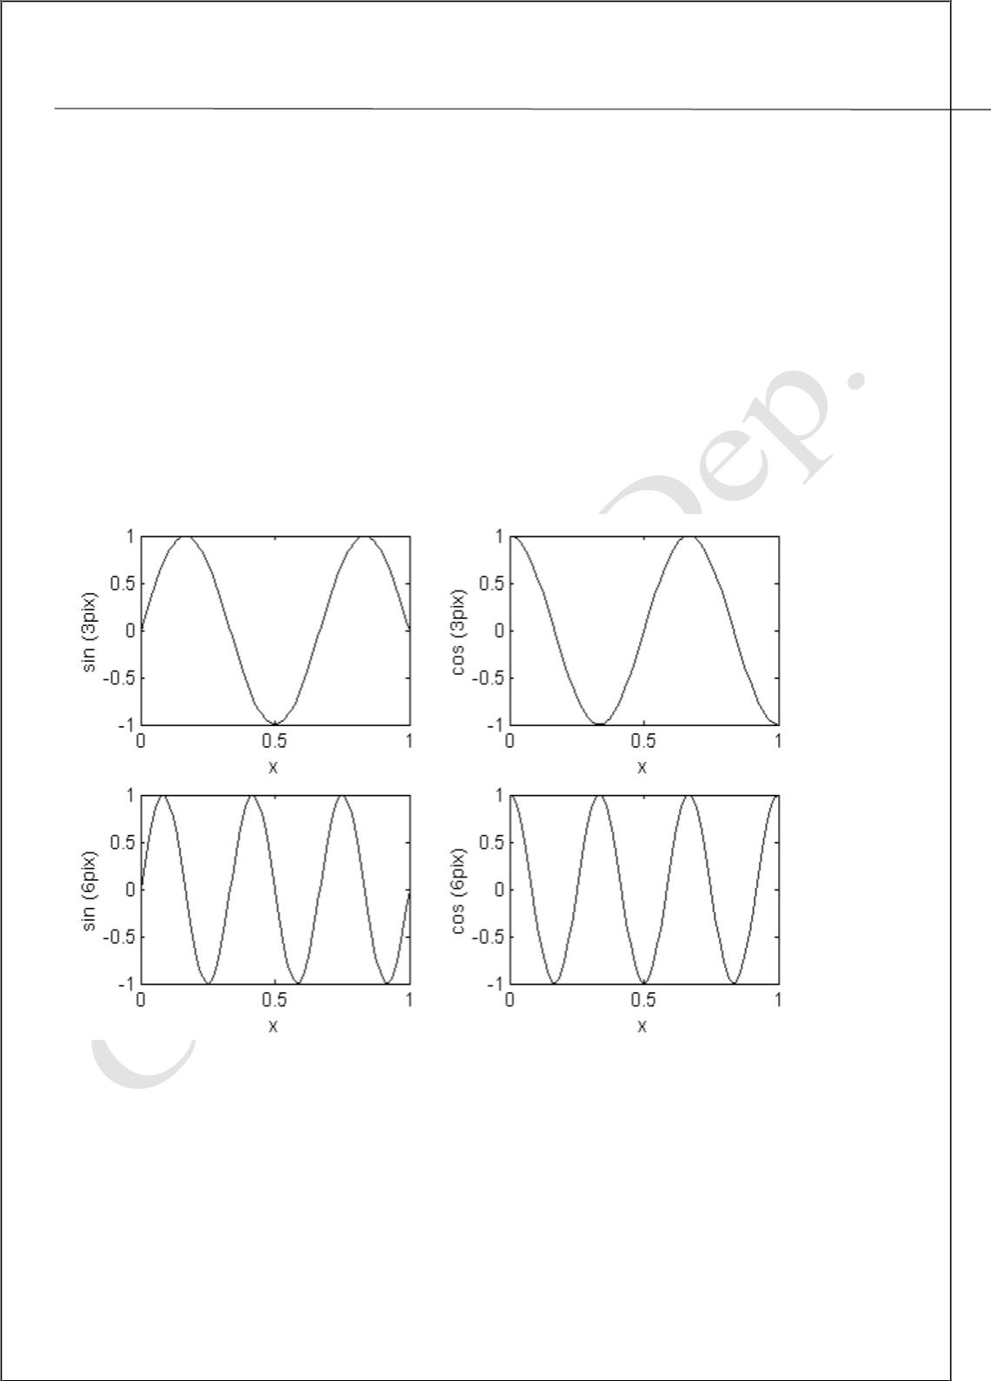
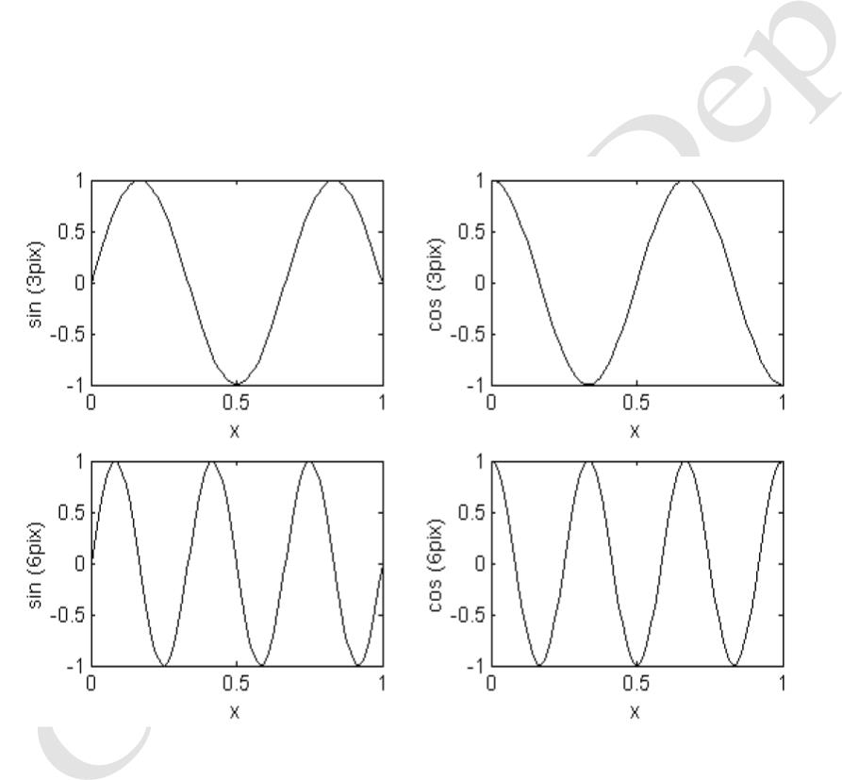
Lecturer
MatLab
Diyala university / College of Engineering
Omar A. Imran
Department of Chemical Eng.
Second Class
2019 – 2020
from the top left. All of plot properties such as hold and grid work on the current
subplot individually.
x=0:.01:1;
subplot(221), plot(x,sin(3*pi*x))
xlabel('x'),ylabel('sin (3pix)')
subplot(222), plot(x,cos(3*pi*x))
xlabel('x'),ylabel('cos (3pix)')
subplot(223), plot(x,sin(6*pi*x))
xlabel('x'),ylabel('sin (6pix)')
subplot(224), plot(x,cos(6*pi*x))
xlabel('x'),ylabel('cos (6pix)')
The re resulting plot is shown in below
Trail Version
Trail Version
Trail Version
Trail Version
Trail Version
Trail Version
Trail Version
Trail Version
Trail Version
Trail Version
Trail Version
Trail Version
Trail Version
45

